Slide 1
УРОК 59

Slide 2
Moscow
Russia
May 30th 2011
Dear Gloria,
Thanks a lot for your letter. Sorry I haven't answered earlier but I was really busy with my school.
I'm glad you are going to visit Moscow. We can go wherever you want but I think you'd like the Kremlin and the Tretyakov Gallery. I've also got some ideas for our nightlife! And if you fancy going to the theatre in the evening, you should bring an evening dress. I'll be delighted if you could get me a T-shirt with views of London.
Well, Mum wants to know what kinds of food you enjoy eating. Do you eat meat and fish? What do you usually have for breakfast? Are there any kinds of food you don't like
Now I've got to do my homework. Please write soon. Can't wait to meet you!
Love,
Kate

Slide 3
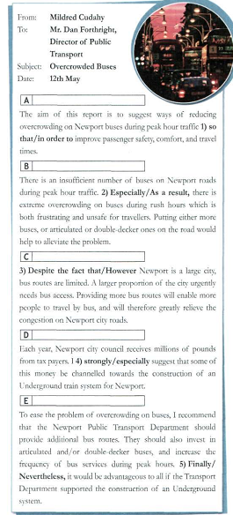

Slide 4
To: (кому)
From: (от кого)
Subject: (тема)
Date: 1st Sept. 2007
INTRODUCTION
State purpose and content of report
MAIN BODY
Summarize each point under subheadings
CONCLUSION
Summarize main points, your opinion

Slide 5
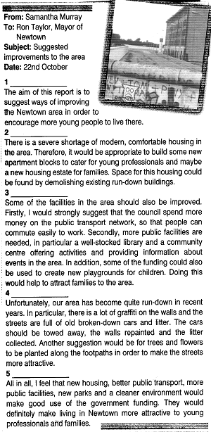
S/B Ex. 3, P.93
Understand the part of a report

Slide 6
Make suggestions, recommendations about
Housing, Facilities, General Environment

Slide 7
Ron Taylor, Mayor of Newtown
Make suggestions, recommendations about
Housing, Facilities, General Environment

Slide 8
Ron Taylor, Mayor of Newtown
Introduction
The purpose of the report is set
Make suggestions, recommendations about
Housing, Facilities, General Environment

Slide 9
Ron Taylor, Mayor of Newtown
Introduction
The purpose of the report is set
Make suggestions, recommendations about
Housing, Facilities, General Environment
Conclusion
Summarize the main parts of the report
Offer a personal opinion

Slide 10
S/B Ex.4b, P.93
Put the correct linking words

Slide 11
Although lots of activities are organized at the community center, they are poorly advertised. For this reason, the centre is not being used as much as it could be.

Slide 12
I would recommend that pop concert be held in the park in the summer so that there is something to interest teenagers too.

Slide 13
To begin with, some of the windows on the first floor are cracked. Secondly, the whole building badly needs repainting.

Slide 14
The entrance hall also needs improving, especially the old- fashioned décor and poor lighting.

Slide 15
It would be a good idea to repaint the community centre in a more modern style. By doing this, we could encourage more young people to participate in activities.

Slide 16
S/B Ex.5, P.93
Rewrite the sentences in more formal style

Slide 17
1) Doing this would make the place more appealing to students.

Slide 18
The purpose of this report is to suggest improvements to the school entrance hall.

Slide 19
The flats are uninhabited and should be demolished.

Slide 20
Finally, I would strongly suggest that language classes be held at the community centre.

Slide 21
The library would attract more residents if it had a larger collection of books.

Slide 22
Ex.6, P.93
Find mistakes, correct them and rewrite the report

Slide 23

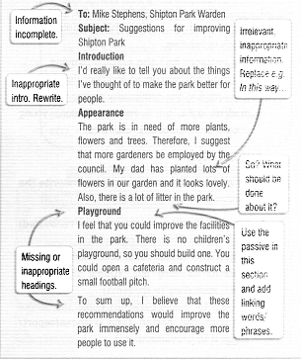

Slide 24
To: Mike Stephens, Shipton Park Warden
From: Stephen Grimes, Assistant Park Warden
Subject: Suggestions for improving Shipton Park
Date: 5th January

Slide 25
Introduction
The aim of this report is to suggest ways of improving Shipton Park to make the park more attractive and popular.

Slide 26
Appearance
The park is in need of more plants, flowers and trees. Therefore, I suggest that more gardeners be employed by the council. In this way, the park would look better for visitors. Also, there is a lot of litter in the park. I strongly recommend an increased number of litter bins and fines for visitors who litter the park.

Slide 27
Facilities
To begin with, I feel the park’s facilities could be improved. At the moment, there is no children’s playground, so one should be built. In addition, a cafeteria could be opened and a small football pitch constructed.

Slide 28
Conclusion
To sum up, I believe that these recommendations would improve the park immensely and encourage more people to use it.

